Slide 1


AUTOMATED SOLAR PANEL CLEANING SYSTEM

Slide 2

TEAM :
TRESMENTIS
Hadia Alvi
22-NTU-CS-1343
Shaham
22-NTU-CS-1373
Subaina Norab
22-NTU-CS-1374

Slide 3
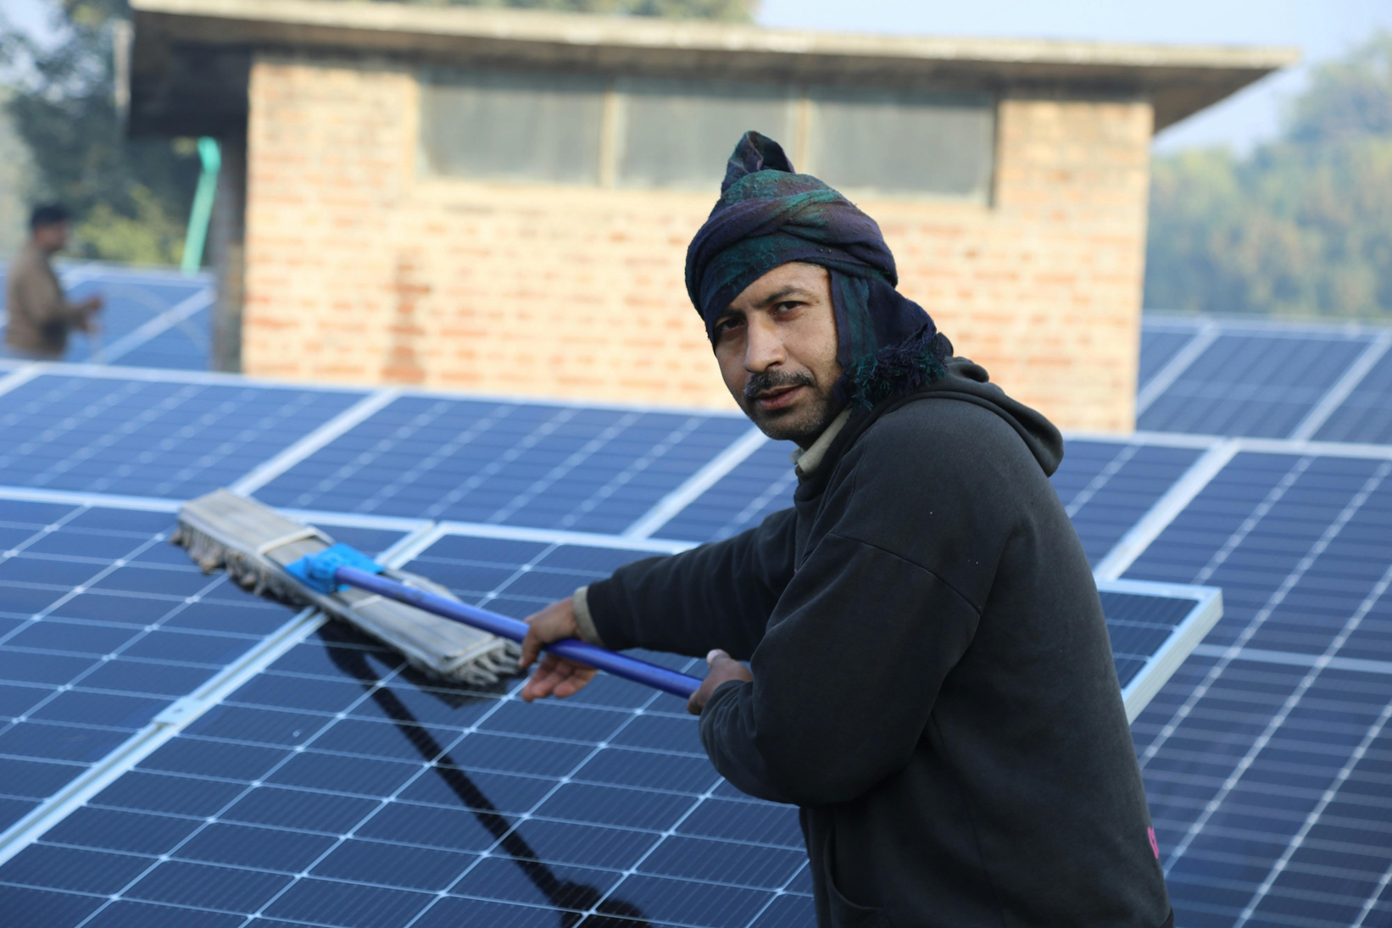

PROBLEM
Page 02
Dust and dirt reduce solar panel efficiency. Manual cleaning is costly, inconsistent, and impractical for large installations.An IoT-based smart system is needed to automatically detect and clean panels, improving energy output and reducing maintenance.
Human cleaning poses safety risks such as potential electric shocks due to contact with high-voltage components.

Slide 4
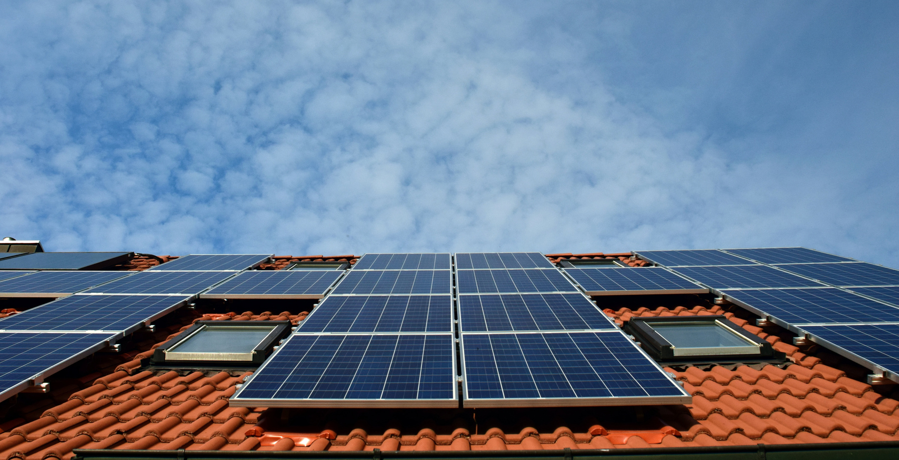
OBJECTIVES
Page 03
Build an IoT-based automatic cleaning system using ESP32-S3.
Monitor dirt level (dirt sensor), light intensity (LDR), and panel efficiency (efficiency sensor).
Enable real-time remote monitoring and manual control via a web interface.
Trigger cleaning only when dirt buildup or efficiency drop is detected.

Slide 5

Page 04
SCOPE
Solar Power Plants
Industrial Solar Setups
Residential Rooftops
Remote/Off-grid Solar Stations
Solar Installations in Dusty, Sandy, or Polluted Regions

Slide 6

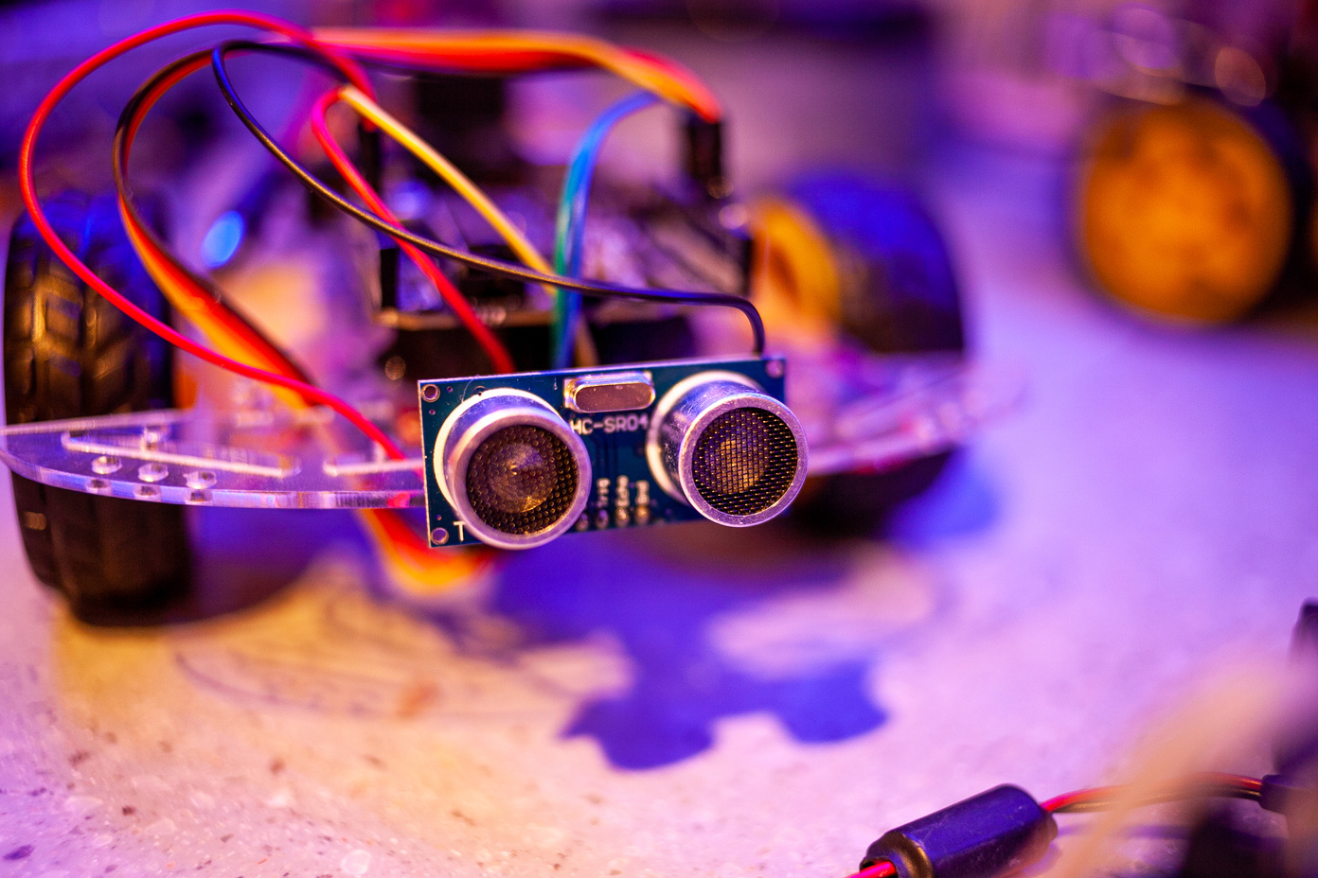
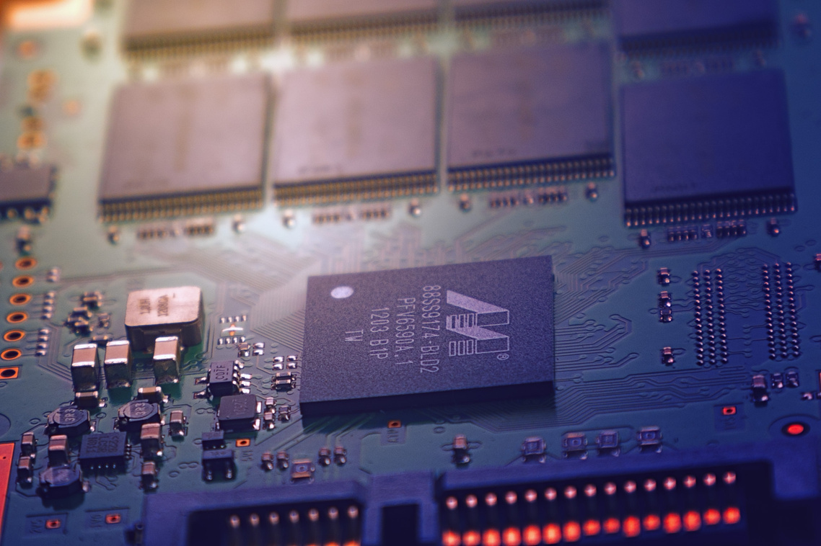
SENSORS
Page 05
ESP32-S3
Dirt Sensor (GP2Y1010AU0F )
Voltage andCurrent Sensor(INA219)
Power Supply
Sprinkler + Valve + Water Source

Slide 7
GP2Y1010AU0F (DUST SENSOR)
Page 05
The GP2Y1010AU0F is an optical dust sensor that detects dust or dirt particles in the air by measuring how much light is scattered . It gives an analog voltage output that increases with dust concentration, which can be read by a microcontroller like the ESP32.
INA219 (VOLTAGE SENSOR)
The INA219 is an I2C sensor that accurately measures voltage, current, and power in a circuit. It's commonly used to monitor batteries, solar panels, or motors with microcontrollers.
Bus voltage (e.g., solar panel voltage)
Shunt voltage across a resistor
Current flowing through the load
Power (calculated internally)

Slide 8


Page 07
SOFTWARE
Arduino IDE / Thonny
ThingSpeak
Firebase
Google Colab / Python

Slide 9

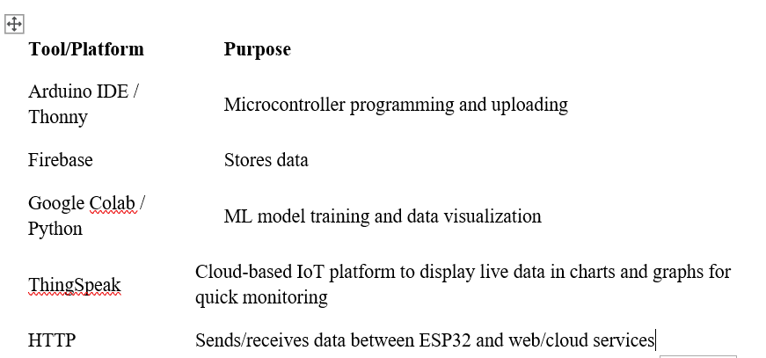

Page08

Slide 10

Page 09
MACHINE LEARNING
We will use Machine Learning for classification which will detect whether solar panel need cleaning or not. It will depend on amount of dust and its efficiency

Slide 11

Page 10
APPROACH
Use INA219 to continuously measure voltage and current from the panel to calculate real-time power output.
Dust sensor to senses dust density near the panel surface.
If model predict that system need clening on basis of real time data , the ESP32 triggers the relay.
Relay activates the 24V solenoid valve to spray water for cleaning.
Data from sensors is logged and sent to Blynk/thingspeak for visualization. Firebase used to store historical data for future ML training.

Slide 12
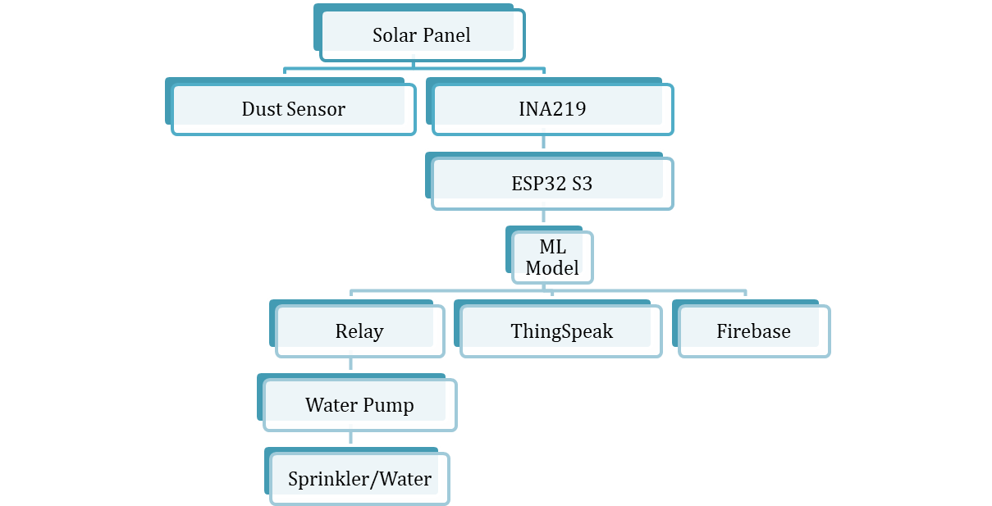
BLOCK DIAGRAM
Page 11

Slide 13
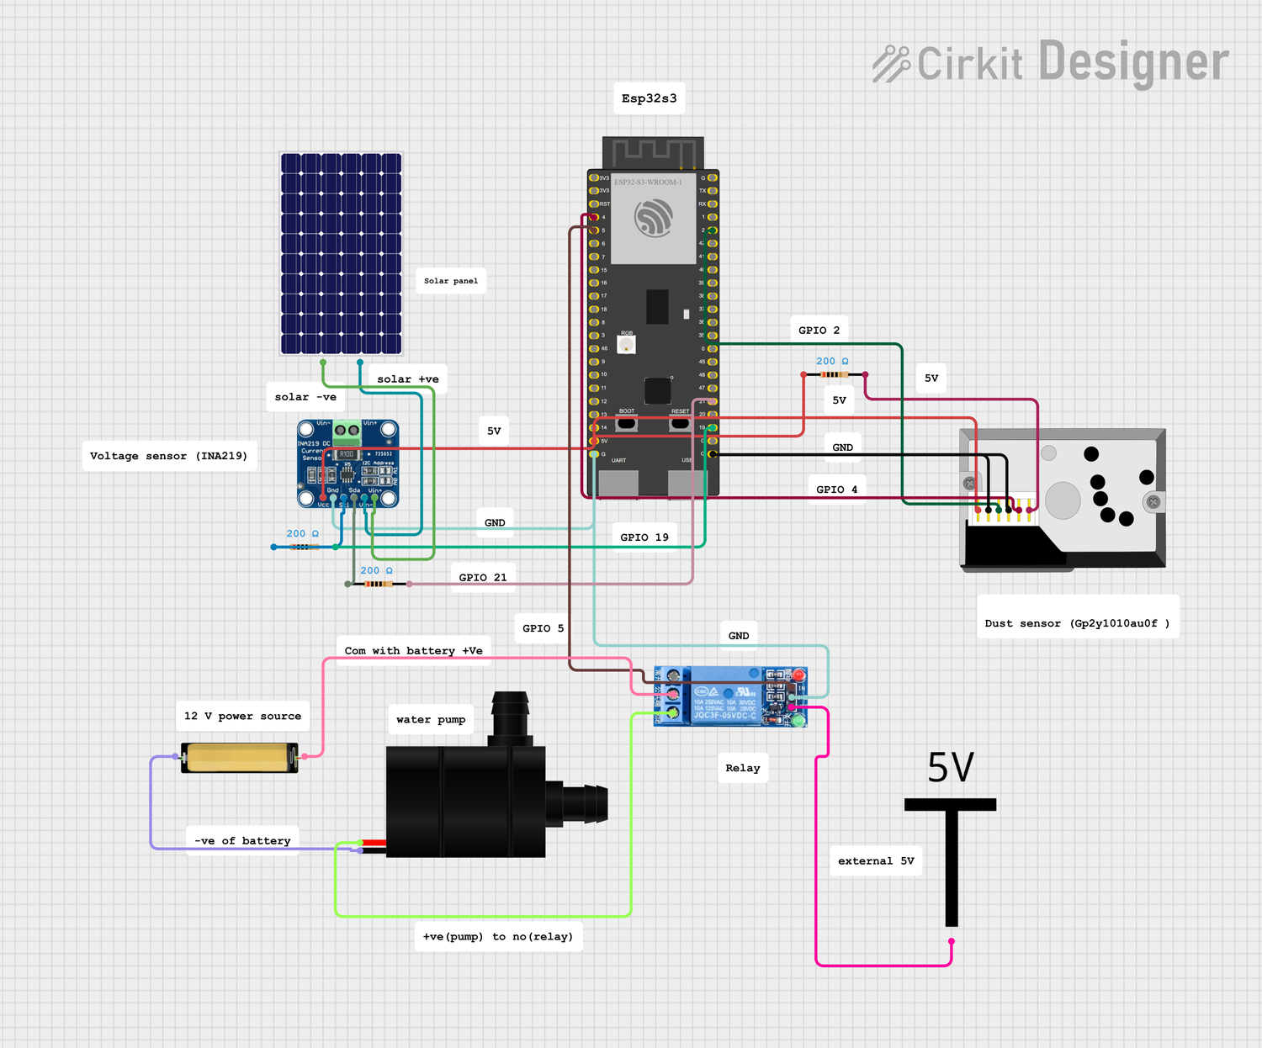
CIRCUIT DIAGRAM
Page 12

Slide 14
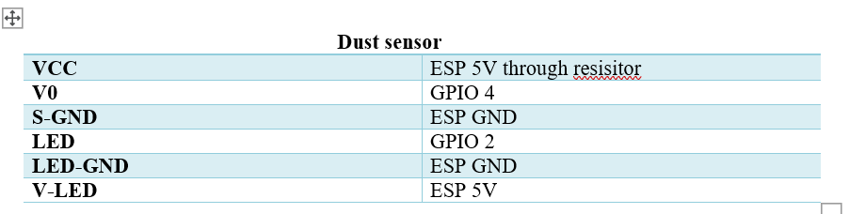
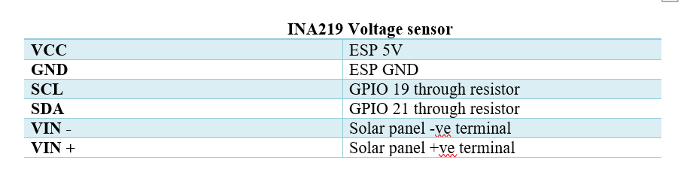
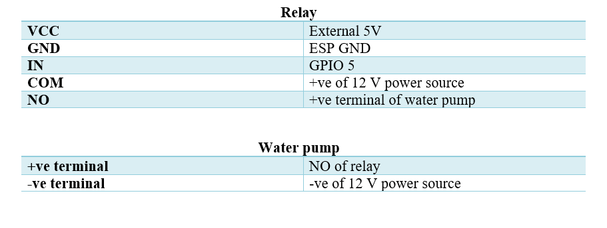
WIRING
Page 13

Slide 15
CHALLENGES & SOLUTIONS
Page 14
INA219 NOT READING VALUES
CHALLENGE: THE INA219 SENSOR INITIALLY FAILED TO RETURN VOLTAGE/CURRENT READINGS.
SOLUTION: EXTERNAL PULL-UP RESISTORS WERE ADDED TO THE I2C LINES (SDA AND SCL), WHICH STABILIZED COMMUNICATION BETWEEN THE SENSOR AND ESP32.
RELAY ISSUE:
CHALLENGE: RELAY WAS JUST KEEPING MOTOR HIGH , NOT TAKING IT LOW
SOLUTION: ESP’S VOLTAGE WERE LEAKED. THIS WAS RESOLVED BY MAKING CONNECTIONS DIRECTLY WITH ESP WITHOUT USING BREADBOARD

Slide 16
FUTURE WORK
Page 15
INTEGRATE SOLAR-POWERED WATER PUMP
EXPAND ML MODEL WITH CURRENT,ACCURACY AND WEATHER
IMAGE BASED CLEANING SYSTEM
A SOLAR TRACKING (ROTATING) SYSTEM

Slide 17
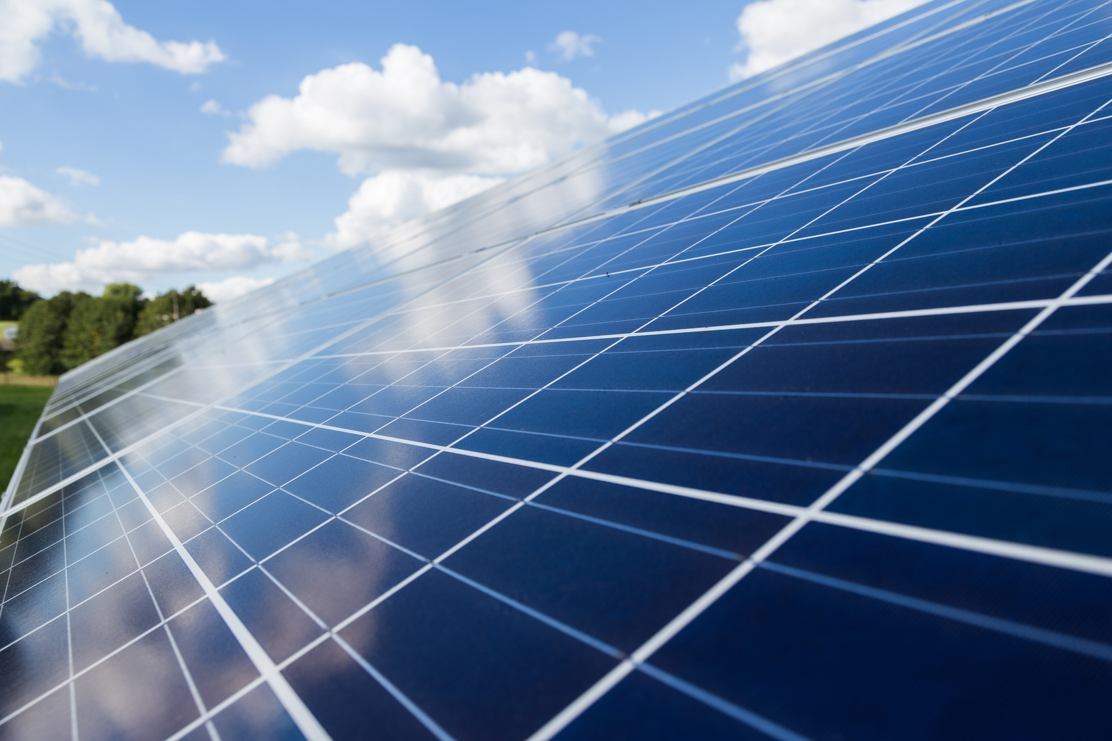
Page 16
THANK YOU FOR YOUR ATTENTION

